Slide 1

Social exploration of games
1
D
Andrea Valente
Emanuela Marchetti

Slide 2

Where do game genres come from?
Is it possible to:
Witness the birth of a genre?
Help a genre to be born?
Typical genres
complexity/fluidity of classification

Slide 3
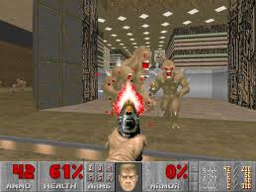
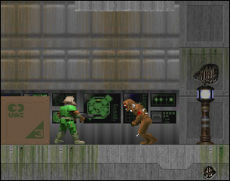
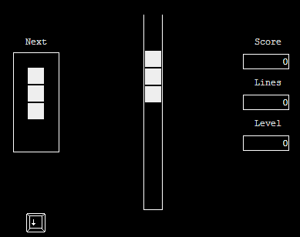

1D games: a non-genre
GENRE
???
Games in 3D, 2D, ... 1D?
Tetris1D ... O_o
joke, not a real game
1D == silly idea / impossible
netnography
confirmed this!

Slide 4
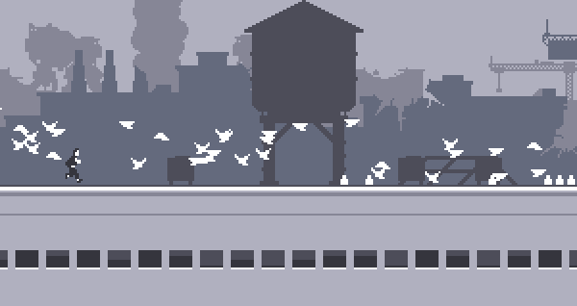
Still... some 1D games do exist
Few, experimental
Z-rox (at Kongregate)
1D bubble -> bubble bubble clone in 1D
Some games might be considered 1D, e.g. CANABALT
(run+jump)
T

Slide 5

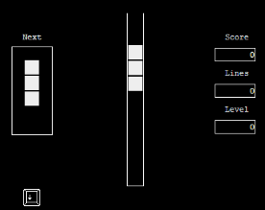
A 1D Tetris more ... Tetris!?
Make a 1D tetris more like the real Tetris
How to define 1D
visualization
playability
How to define LIKE
game identity
Obective, intra-subjective, subective

Slide 6

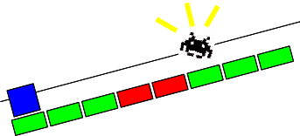

What is a game in 1 dimension
Def: a line of pixels ( or ), still playable
4 possible visualizations
B/W
Color
“Rich”
Artistic
1 bit == 1 pixel
color coding == icons
actual icons
Or even:

Slide 7
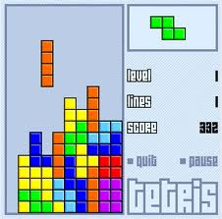
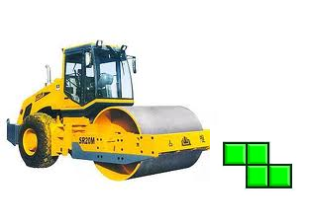
Game Identity and flattening
Flattening is the operation that re-defines a 2D game as 1D
(consider Tetris)
What constitutes the identity of a game?
How will loosing 1 dimension alter game dynamics?
DEMO:
2 possible flattenings for tetris https://dl.dropbox.com/u/1518199/1D%20games/index.html

Slide 8
Structuralist analysis
1- consider the pieces
2- consider all possible operations on the pieces
3- find out typical strategies/problems when playing the game, that emerge from 1 and 2
Then:
1- consider how pieces would be in 1D
2- consider which operations can be defined on the 1D pieces, that remind of the original operations. Strategies too.
3- what does emerge from 1 and 2? How does that relate to 3?
Also found general mappings from 2D to 1D
time VS space
And explored 1½D games (soko1D)

Slide 9

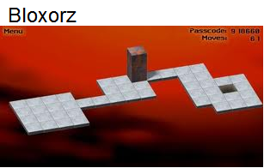
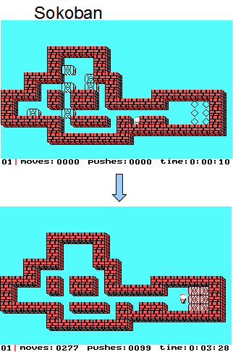
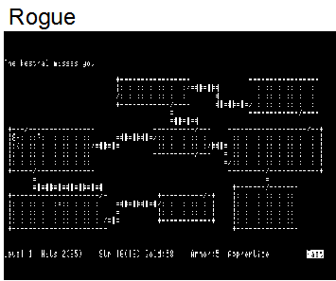
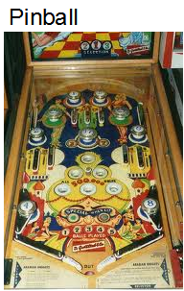
Experimental frenzy rapid prototyping in javascript

Slide 10



Poke at the net
Posted about 1D games in 2 forums and FB
Reactions:
Resistance: ”Not really 1D”
Acceptance:
general positive feedback
”shows graphics is not all in a game”
way to ”think outside the box”
Simpaty
”I did it too”
”I know some games that might be 1D”
”I want to try this 1D too!”

Slide 11


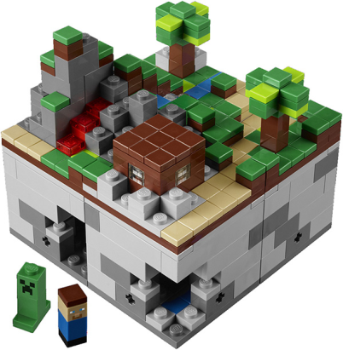
Lessons on game development from 1D games
1D forces you to think hard about visuals as well as gameplay
Minimalistic approach
in-place 1D 1B B/W
nice and easy to visualized and design
related to Turing Machines (state machines)
could be used for tangible games/learning
Explore the space of all possible 1D 1B B/W games ... automatic generation of playable games
Arduino + RGB LEDs as HW

Slide 12


Conclusion and future work
1D forces you to think outside the box -> restrictive yet creative
rapid prototyping works well with 1D games
perhaps we did not force this new game genre into being, but …
Have more people play and ask them feedback
Simplify the coding -> more players should be able to make their own 1D game
Create a physical platform (arduino + LEDs ?) to play with 1D games development
Explore aesthetics of 1D and create NEW 1D games, not replicas of existing games
including tangible representations for visuals
1D games as deconstruction of game, animation and interaction
To teach/Learn something about HCI with 1D games
Minimalistic approach: 1D 1B B/W games
simple, high contrast games
explore the space of these 1D games
automatic generation of playable games

